Slide 1
Mining NIH Grant Data

Slide 2
Agenda
Data overview – NIH grants data
Database ERD
General statistics
Network Analysis
Geospatial representation of data
Feature reduction for clustering
References

Slide 3
Data overview
~2.2 million NIH grants
~30 years (1985-present)
~253 thousand PIs
~118 thousand terms
~57 million grant-term relations

Slide 4
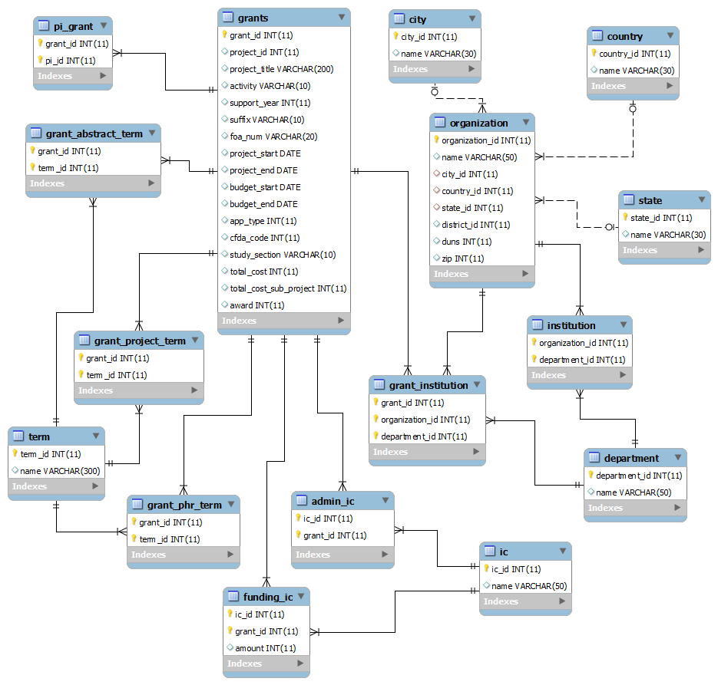
ERD

Slide 5
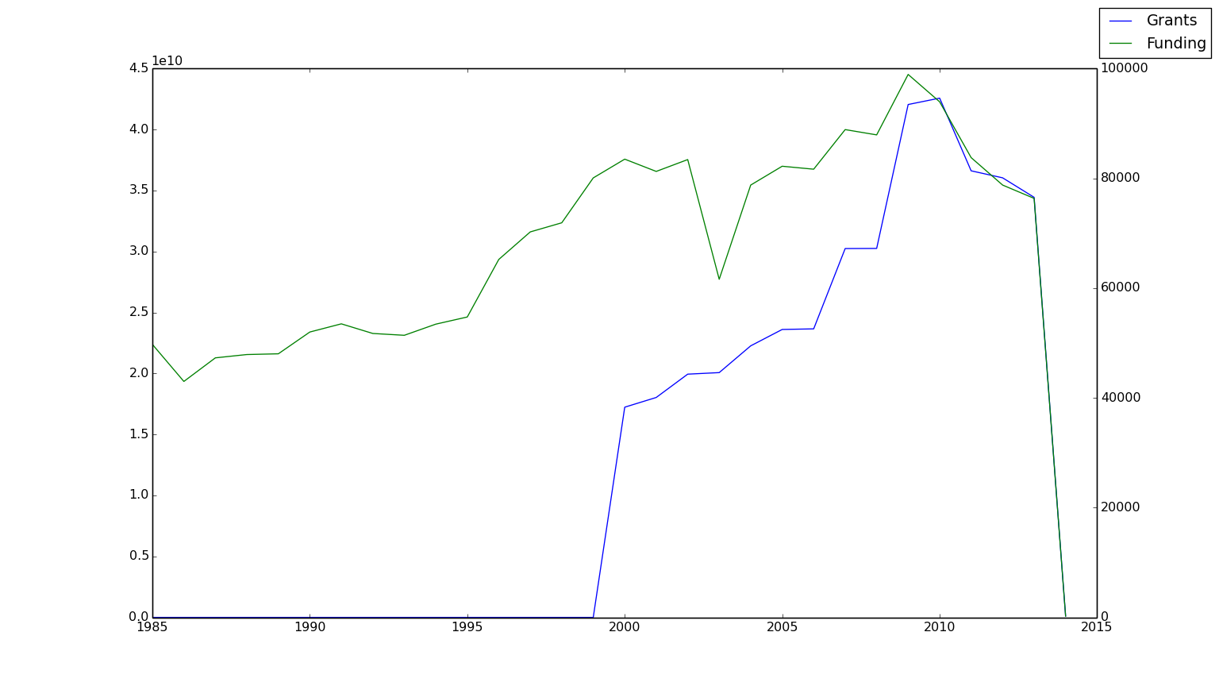
General statistics Grants per year

Slide 6
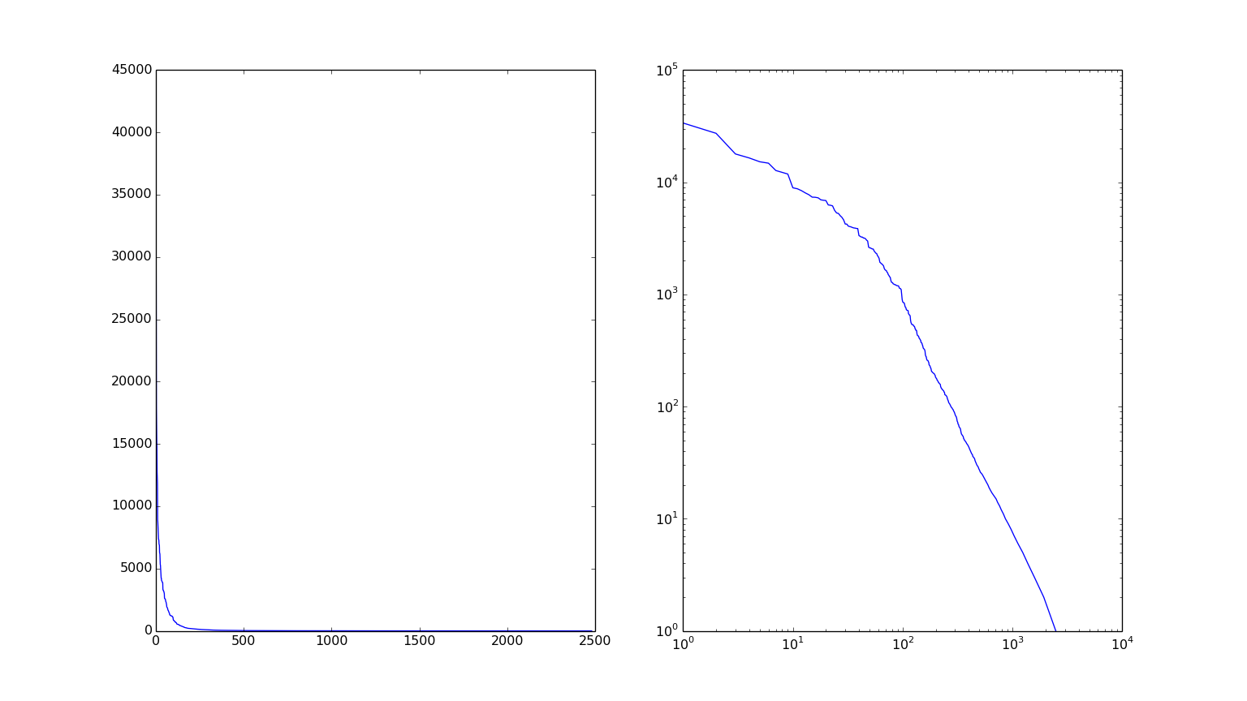
General statistics Grants per city

Slide 7
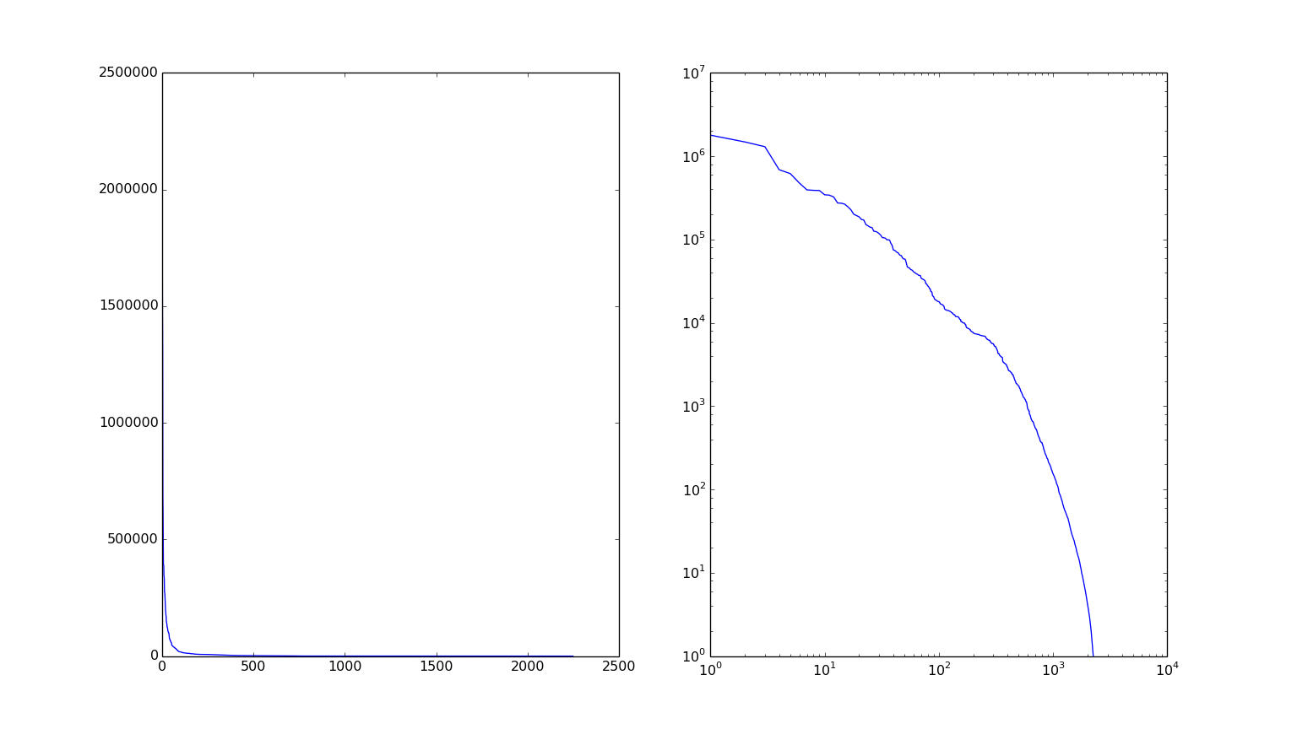
General statistics Grants per county

Slide 8
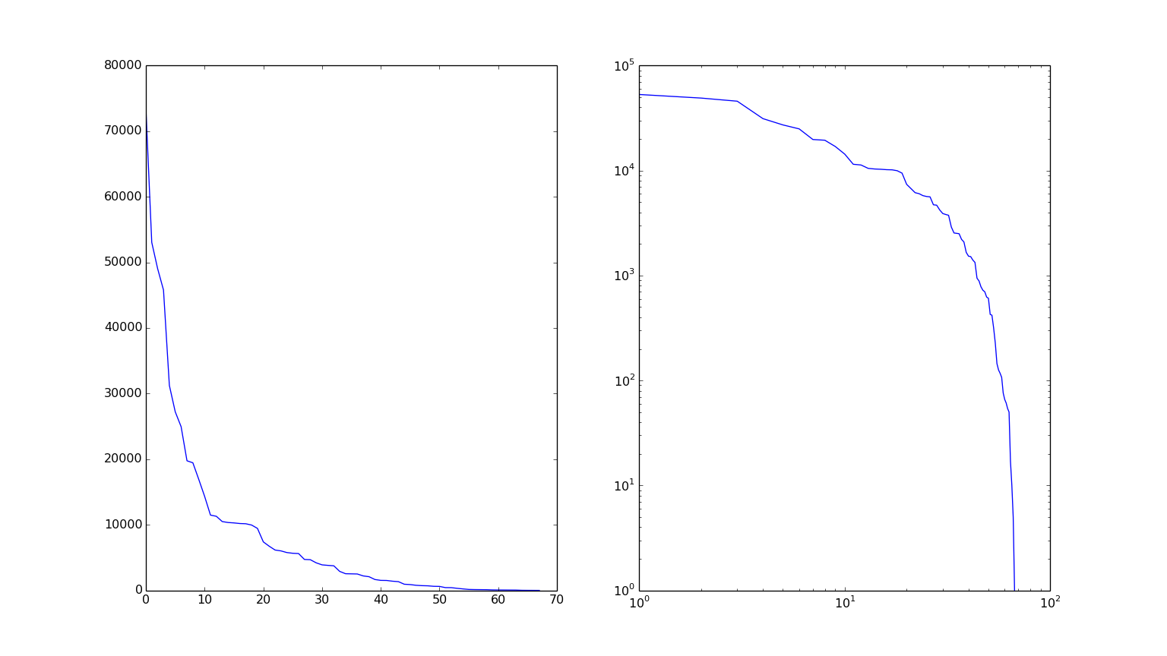
General statistics Grants per state

Slide 9
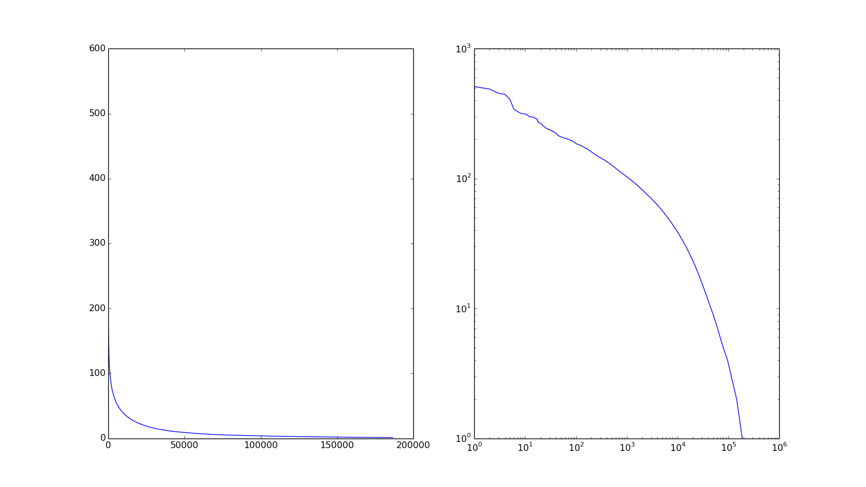
General statistics Grants per PI

Slide 10
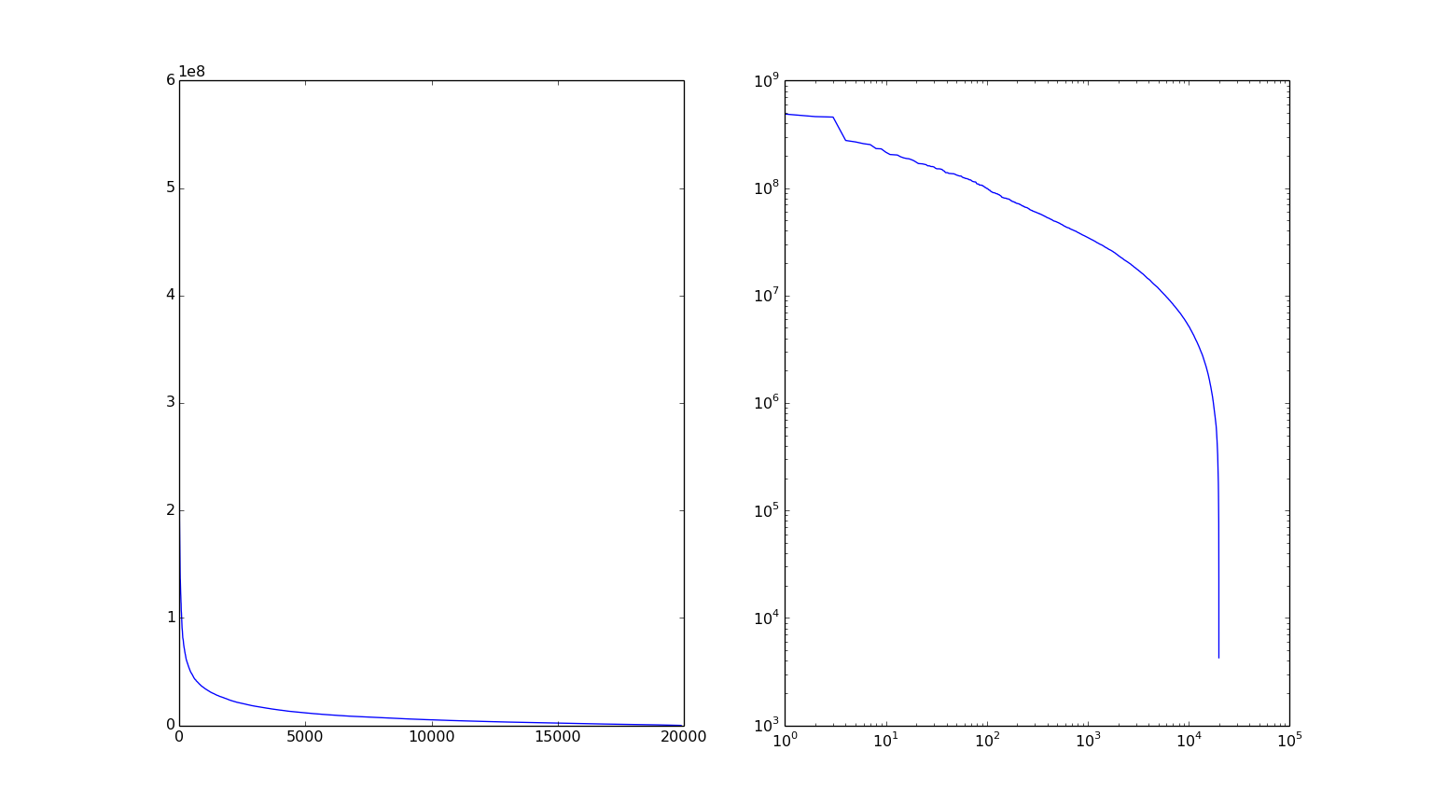
General Statistics Funding per PI

Slide 11
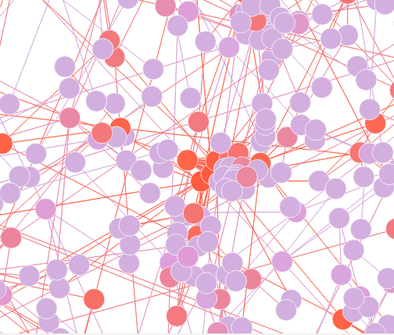
Network Analysis Co-PI network
Closeness
Betweeness
Network Constraint
Clustering Coefficient
PageRank

Slide 12
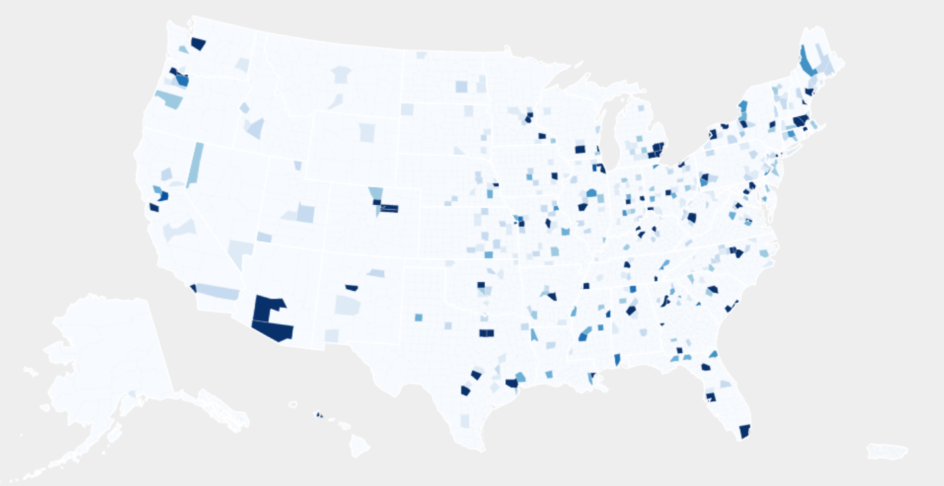
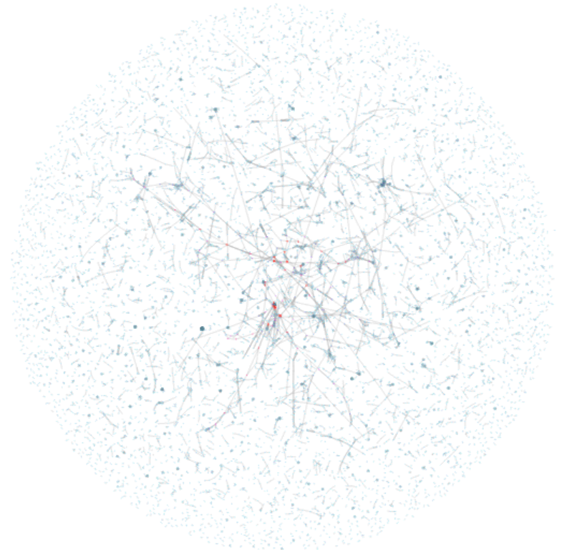
Network Analysis Data visualization

Slide 13
Clustering Grants by Keywords
50th of dataset
Equal distribution of years
Used Deep Autoencoder Network to reduce from 438->200->100->50->25->2
Each grant now represented by 2 features, x and y, and can be plotted

Slide 14
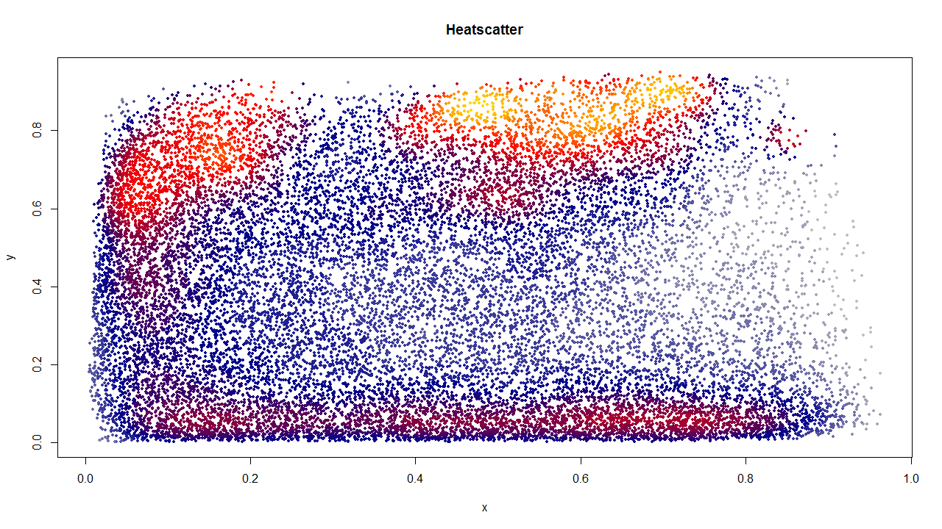
Clustering Grants by Keywords

Slide 15
References
NIH
Hive
SNAP

